Slide 1
Big Data and Database Management
Big Data
MOVIE DATASET ANALYSIS

Slide 2
TABLE OF CONTENTS
01
PROJECT SCOPE & OBJECTIVE
02
DATABASE INTEGRATION
03
DATA PREPROCESSING
04
DATA ANALYTICS IN APACHE SPARK
05
MOVIE RECOMMENDATION SYSTEM
06
CONCLUSION

Slide 3
PROJECT SCOPE & OBJECTIVE
Big Data

Slide 4
OUR PROJECT
We have chosen “Movie dataset analysis” as our Project topic.
The novelty behind this project is to explore the patterns and the trends from the plain dataset that only contains the information about each movie.
The reason to choose this project is to learn how to use Apache spark & database like MySQL to perform analysis derive meaningful insights.
We felt that the movie dataset gives us the flexibility to perform all the analysis and it also motivated us to build a recommendation system.
“Our goal is a build a live movie dashboard and recommendation system based on analysis performed on the dataset.

Slide 5
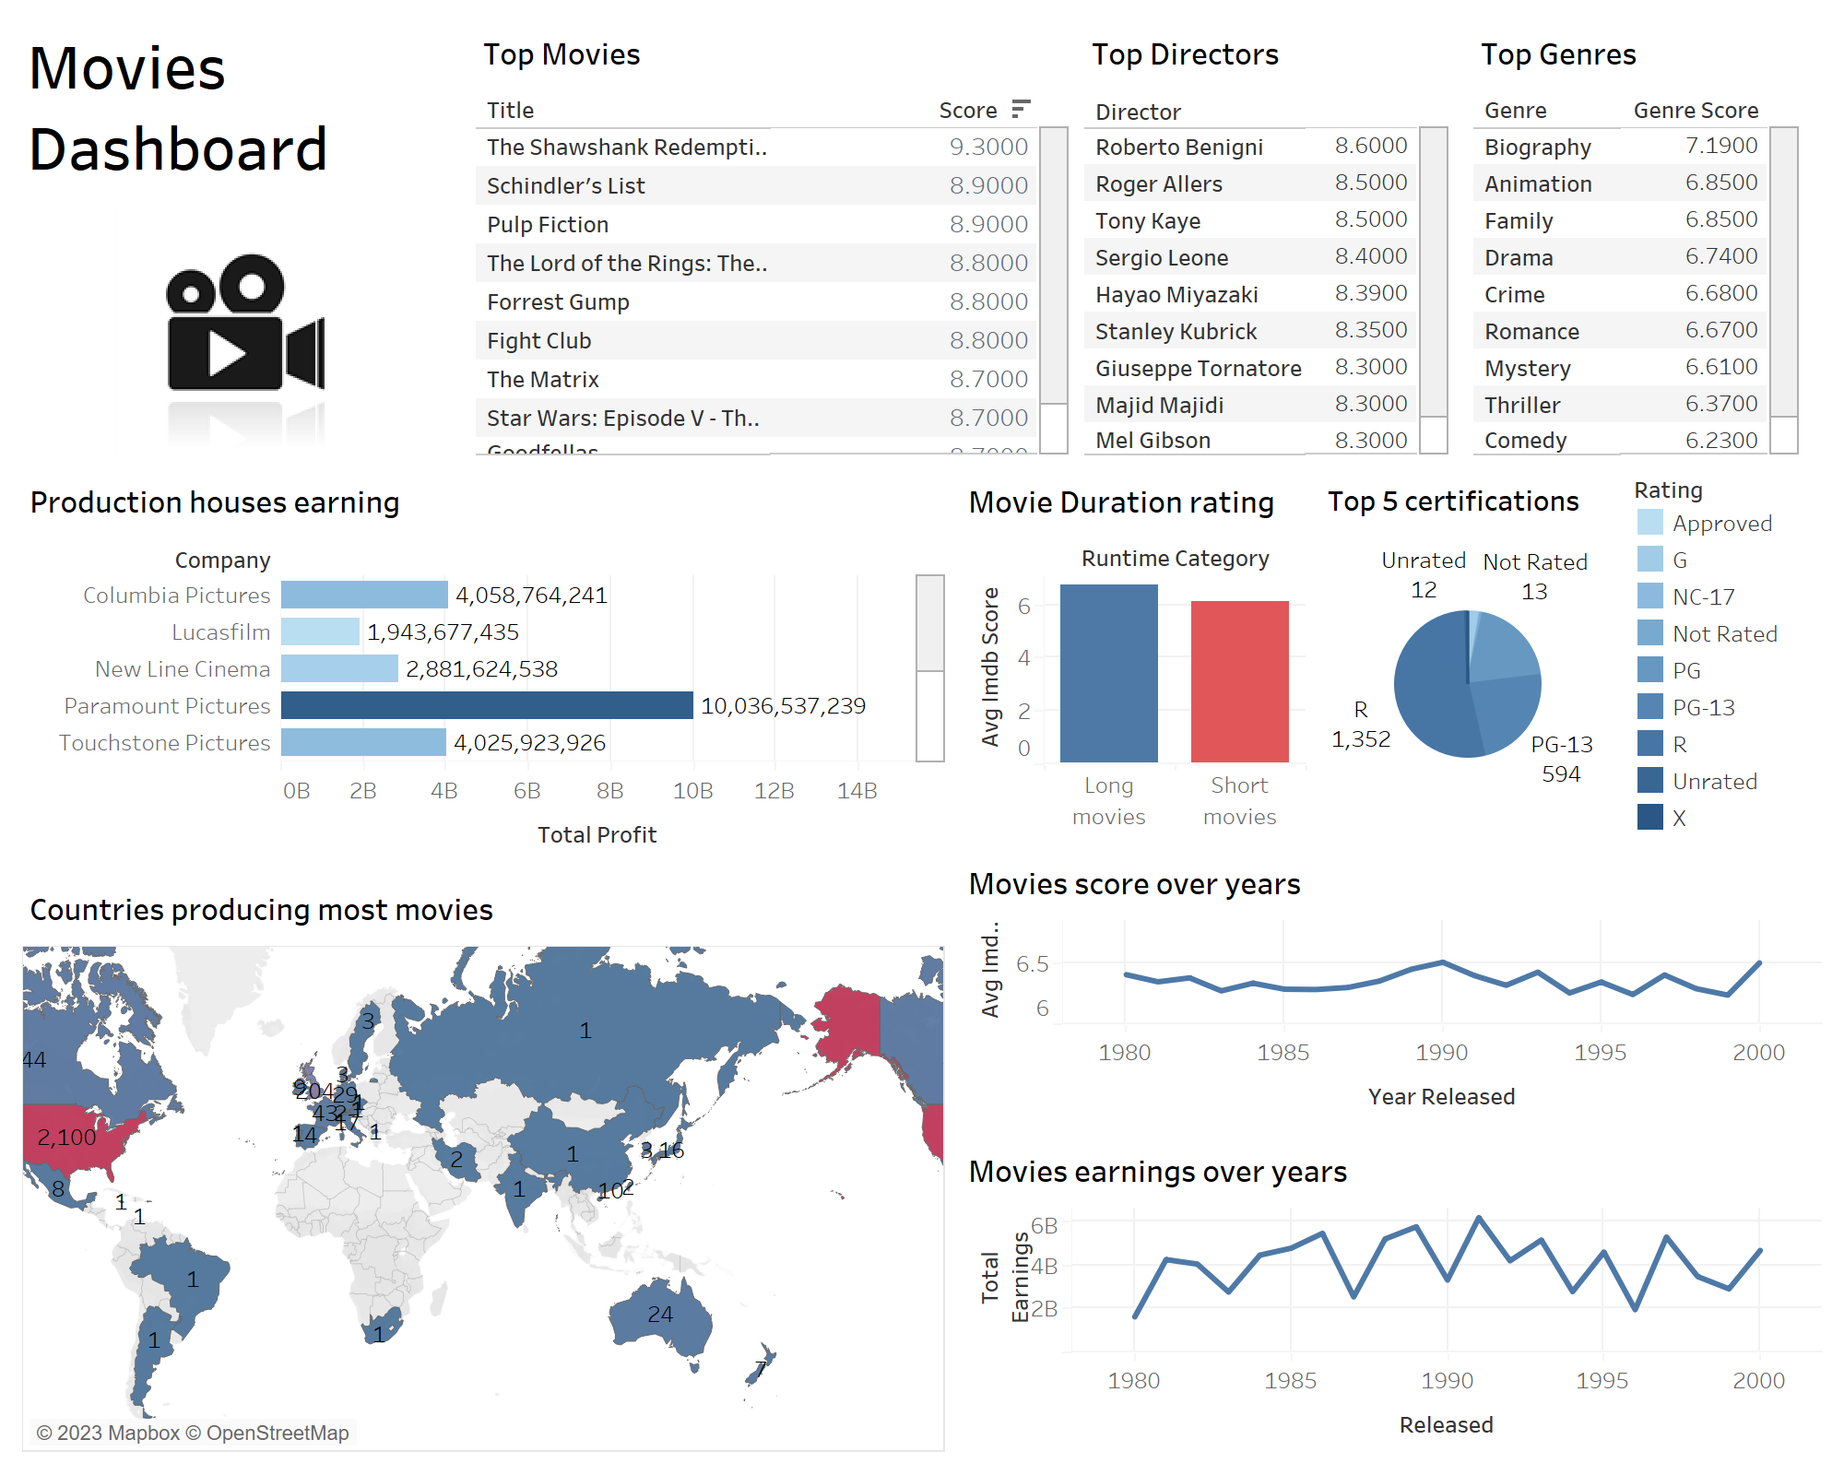

Slide 6


Slide 7
ABOUT THE DATASET
Title
Rating
Genre
Released
Score
Extracted from the Kaggle website and gives contains various attributes associated with various films.
The raw dataset collected consists of totally 4000 samples and 13 attributes.
Votes
ATTRIBUTES
Director
Star
Country
Budget
Gross
Company
Runtime

Slide 8
DATABASE INTEGRATION
Big Data

Slide 9
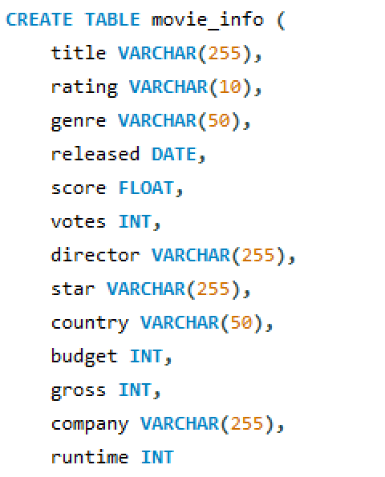
Defining a Table in MySQL for loading the data

Slide 10
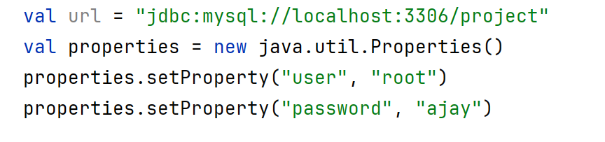
Integrating SQL Database with Spark

Slide 11
DATA PREPROCESSING
Big Data

Slide 12
DATA PREPROCESSING
The raw data extracted from the dataset might contain some null values, duplicate value or some redundant data.
So, processing the data to remove these unnecessary data is necessary and crucial for ensuring the quality and reliability of the data.
Preprocessing done for our dataset –
1) Handling the null values
2) Checking for Duplicate entries
3) Filtering zero values
The refined dataset is well-prepared for subsequent analyses, providing a reliable foundation for deriving meaningful inferences.

Slide 13
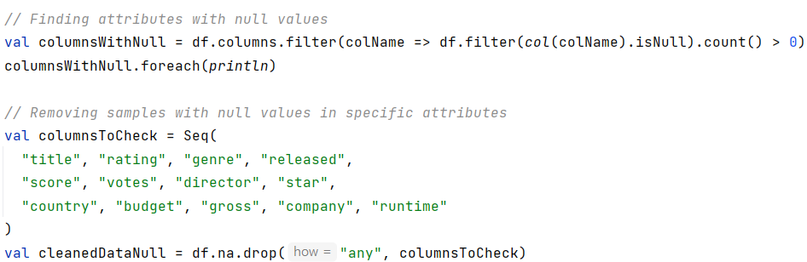
Handling the Null values
The code first identifies columns with null values by checking each column for null entries and prints them.
The resulting data frame, cleanedDataNull, represents the dataset after handling null values in the specified attributes.

Slide 14
Output after Handling the Null values
The null values are found in the total of 4 attributes and are removed.

Slide 15
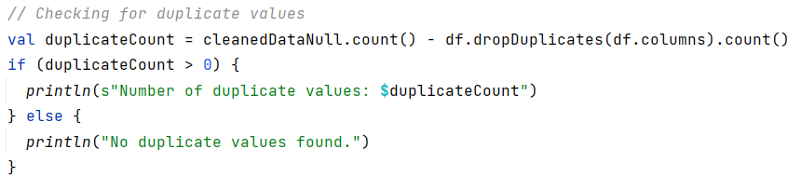
Handling the Duplicate Entries
The code first calculates the difference between the total count and the count of distinct rows after removing duplicates.
If duplicates are present, the code provides information about the number of duplicate values.

Slide 16
Output after Handling the duplicate entries
It was found that there are no duplicate entries in the dataset.
Now the dataset is ready for further processing.

Slide 17
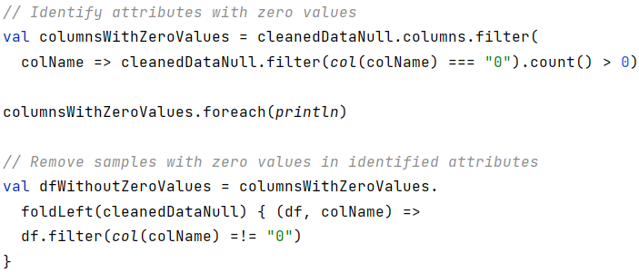
Handling the Zero values
Our dataset contain totally 5 attributes that store ‘numbers’. So, having zero values in them disrupts the data consistency. Hence, it is necessary to remove these zero values.
This code snippet first identifies the columns that contain the zero values. After finding the attributes that contain zero values, they are removed.
Notes:
val outputPath = "D:\\SEM - 5\\DBMS\\PROJECT\\BDMS PROJECT\\src\\main\\scala\\top_movies.csv"

Slide 18
Output after Handling the Zero values
It was found that the attribute ‘budget’ has zero values in it. And hence the they are removed.
Now the dataset is ready for further processing & analysis.

Slide 19
DATA ANALYSIS IN APACHE SPARK
Big Data

Slide 20
TOP10 Based Analysis
The Top 10-Based Analysis segment of our project focuses on identifying and showcasing the top performers within specific categories.
We have done the following analysis in this segment,
- > Top 10 movies based on IMDB scores
- > Top 10 liked genres based on average of IMDB scores
- > Top 10 successful directors based on average of IMDB scores
For this analysis, the main APIs used are groupBy(), orderBy() along with the limit() to display the top10 performers.

Slide 21
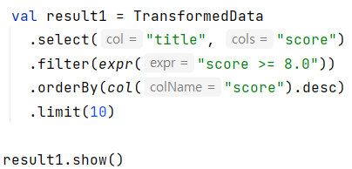
1) Top10 movies based on IMDB score
The code snippet aims to find the top10 movies based on the IMDB scores.
First selection of columns ‘title’ & ‘score’ are done on the ‘TransformedData’ variable that holds the preprocessed dataset.
After that, a filter operation is performed based on a condition to extract the movies that are highly rated by the people. It is followed by ordering those items and displaying top10 movie names.

Slide 22
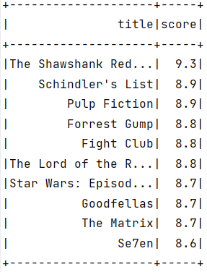
This is the output for Top10 movies based on IMDB score

Slide 23
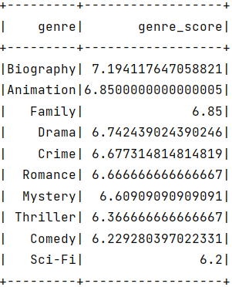
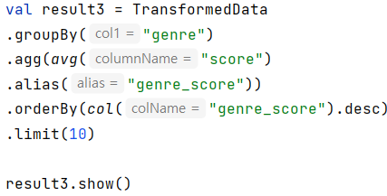
2) Top10 Genres based on IMDB score

Slide 24
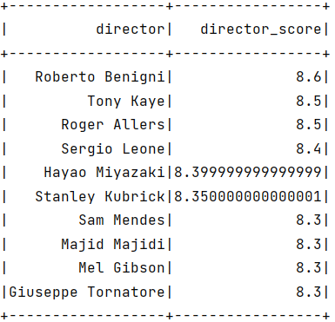
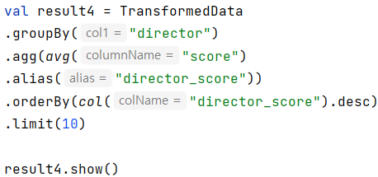
3) Top10 Directors based on IMDB score

Slide 25
Company Based Analysis
The Company-Based Analysis segment of our analysis aims to access the performance of production companies within the movie industry.
This analysis in identifying the top-performing or most successful production companies based on financial success or production volume.
We have done the following analysis in this segment,
- > Companies producing the most movies along with their average scores
- > Companies which made the most profit over the span of 20 years
Based on this analysis, the production companies can get help in strategic decision making within the industry. They can use this information to optimize their content creation or investment decisions.

Slide 26
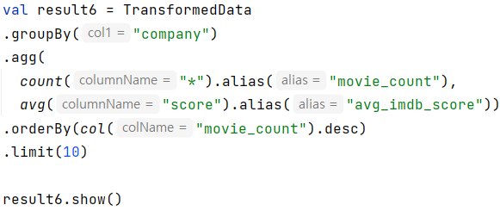
1) Companies producing most movies
The code snippet aims to find the top 10 companies based on the volume of movies they are producing where the average IMDB score is also included.
It starts by aggregating the count of movies and calculating the average IMDb score for each production company.
Then the data frame is ordered in descending order to display top10 contents.

Slide 27
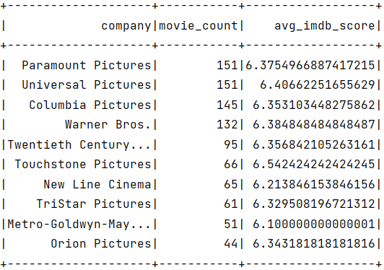
Inferences
From the output, the production houses that are generating a greater number of movies are Paramount and Universal Pictures.
Touchstone Pictures, despite producing fewer movies (66), stands out with a relatively higher average IMDb score (approximately 6.54). This suggests a potential focus on producing movies with a higher level of audience appreciation.
This analysis provides insights about the companies that has better audience reception. Studios, such as Paramount Pictures and Universal Pictures, have maintained a consistent level of audience satisfaction across a number of productions.

Slide 28
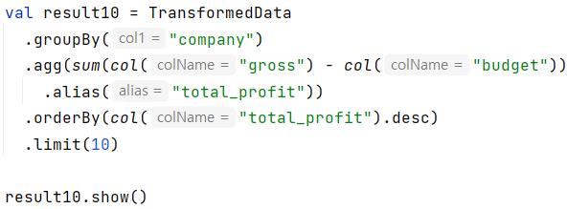
2) Companies who made the most profit
The code snippet aims to find the top 10 companies who made the most profit out of the movies.
It starts by calculating the total profit made by each production company by subtracting the budget from the gross for each movie.
Then the data frame is ordered in descending order to display top10 contents.

Slide 29
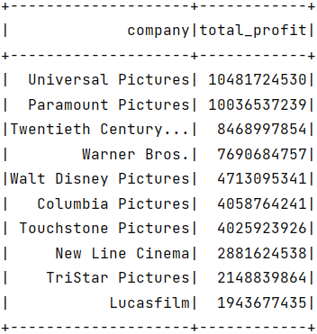
Inferences
Universal Pictures and Paramount Pictures emerge as the top two companies, making substantial profits of approximately $10.48 billion and $10.04 billion, respectively.
This indicates their financial success in the film industry over the analyzed period.
The stakeholders can utilize this information to collaborate with the successful production houses. This will generate many opportunities for them.
This analysis emphasizes the importance of financial success beyond production volume and that helps stakeholders to make informed decisions.

Slide 30
Country based Analysis
The Country-Based Analysis segment of our analysis focuses on analyzing the movie data based on the countries of origin.
This analysis provides valuable insights into the contributions of different countries to the global cinematic landscape.
We have done the following analysis in this segment,
- > Countries which made the most profit
- > Countries that produced the best films based on average IMDb score
- > Movies count released by each country
Based on this analysis, we can gain insights on the cultural influence on the quality and reception of movies across the different countries. We can also identify the emerging markets in the movie industry.

Slide 31
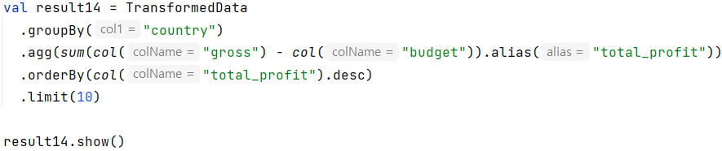
1) Countries which made the most profit
The code snippet aims to find the top 10 countries that bagged in the highest profit from the movie industry.
It starts by aggregating the total profit for each country's films and group them on the attribute ‘country’.
Then the data frame is ordered in descending order to display top10 contents.

Slide 32
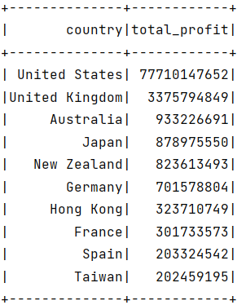
Inferences
The United States significantly dominates the list, showcasing an immense total profit of approximately $77.71 billion.
This output does not solely align with countries producing the highest number of movies. It indicates that profitability is influenced by factors such as box office success, international appeal, and cost-effectiveness.
This analysis provides insights about the contribution of the film industry to the country’s revenue.

Slide 33
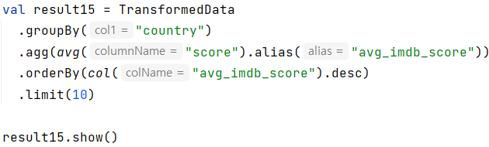
2) Countries that produces best movies
The code snippet aims to find the top 10 countries that produce the best movies based on the IMDB scores for the films.
It starts by grouping the data frame on the ‘country’ attribute and then aggregating the result based on the average score of each country.
Then the data frame is ordered in descending order to display top10 contents.

Slide 34
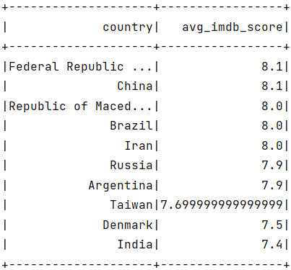
Inferences
From the output, The Federal Republic of Germany and China share the top position, each producing films with an impressive average IMDb score of 8.1.
This indicates a high level of audience appreciation for movies from these countries.
This analysis can provide insights into which country attracts most number of viewers. This can help the countries to work on their content generation.
China, Taiwan, and Iran, representing Asia, secure positions among the top countries producing films with the best average IMDb scores. This emphasizes the growing influence and recognition of Asian cinema on the global stage.

Slide 35
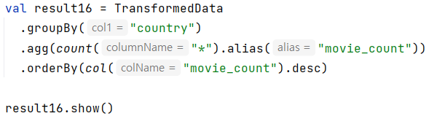
3) Movies count released by each country
The code snippet aims to find the total number of movies that each country released.
It starts by grouping the data frame on the ‘country’ attribute and then it aggregates the count of movies for each country.
Then the data frame is ordered in descending order to start displaying countries with highest number of movies released.

Slide 36
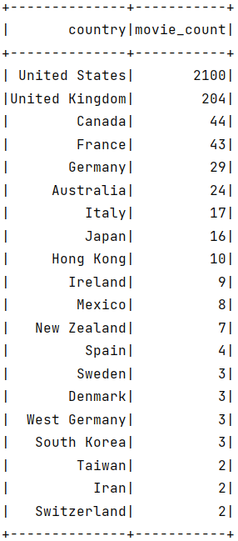
Inferences
The United States emerges as the dominant contributor to the dataset, releasing a significantly higher number of movies (2100) compared to other countries.
This analysis reflects a diverse set of countries contributing to the movie industry where we can find out interest of people of a particular country in film making.
We can also get insights into contribution of different parts of world towards film industry such as from Asian countries, European countries etc.
From this analysis, we can also find out the emerging movie markets in different countries.

Slide 37
Year based Analysis
The year-based Analysis segment of our project provides valuable insights into the financial performance and economic dynamics of the film industry.
Benchmarking the financial performance of different years provides a basis for planning future projects for the film makers.
We have done the following analysis in this segment,
- > Movies Released per year
- > Trend of profits earned per year

Slide 38
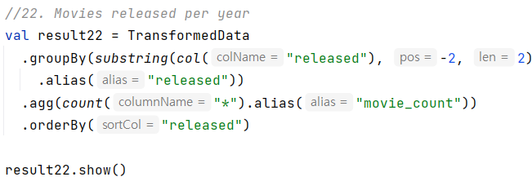
1) Movies Released per year
The code snippet aims to find the count of movies released over the years.
It starts by grouping the Data Frame by the last two characters of the "released" attribute, representing the year of release. Then it aggregates the count of movies for each year.
Here, the substring function takes 3 parameters: the column to be extracted from, the starting position of the substring, and the length of the substring.

Slide 39
Inferences
+--------------+--------------+
| released |movie_count|
+--------------+--------------+
| 1980| 112|
| 1981| 127|
| 1982| 122|
| 1983| 114|
| 1984| 116|
| 1985| 119|
| 1986| 143|
| 1987| 115|
| 1988| 132|
| 1989| 144|
| 1990| 129|
| 1991| 139|
| 1992| 120|
| 1993| 134|
| 1994| 98|
| 1995| 118|
| 1996| 124|
| 1997| 120|
| 1998| 108|
| 2000| 112|
+--------------+--------------+
The analysis reveals variations in the number of movies released each year. For example, there is an increase in movie production from the 1980s to the early 1990.
The late 1980s and early 1990s mark a period with a high count of movie releases, with peaks in 1986, 1989, and 1991.
These peak may indicate the increased activity and creativity in the industry during this timeframe. It might indicate that best quality movies are produced in that time.

Slide 40
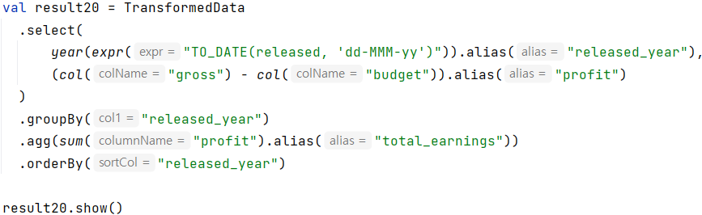
2) Trend of profits earned per year
This code snippet first extracts the year from the "released" attribute and calculates the profit for each movie by subtracting the budget from the gross.
Then it groups the Data Frame by the "released_year" attribute and then aggregates the sum of profits for each year. Finally, it orders the data frame to display the results

Slide 41
Inferences
+------------------+-------------------+
|released_year| total_earnings|
+------------------+-------------------+
| 1980| 1638301562|
| 1981| 4275418246|
| 1982| 4068890475|
| 1983| 2781326807|
| 1984| 4481357786|
| 1985| 4801005826|
| 1986| 5484895674|
| 1987| 2558310082|
| 1988| 5222178985|
| 1989| 5787948374|
| 1990| 3334403476|
| 1991| 6206809440|
| 1992| 4221823453|
| 1993| 5175983003|
| 1994| 2800221983|
| 1995| 4621467498|
| 1996| 1969816312|
| 1997| 5312024581|
| 1998| 3493821414|
| 2000| 4695351392|
+------------------+-------------------+
The net gross of the movies have been fluctuating each year, but it can be observed that over the decade, there has been a rise in the earnings of film industry.
It can be observed that the year 1991 saw a huge spike in the movie earnings compared to previous year even though the number of movies produced is almost same.
This shows the quality of produced in the year 1991.

Slide 42
Movie run-time based Analysis
The runtime - based Analysis segment of our project focuses on finding out whether people prefer movies of longer or shorter duration.
This analysis also tells us about the average runtime of the movies released in between 1980 & 2000.
We have done the following analysis in this segment,
- > People’s choice of Movie run-time

Slide 43
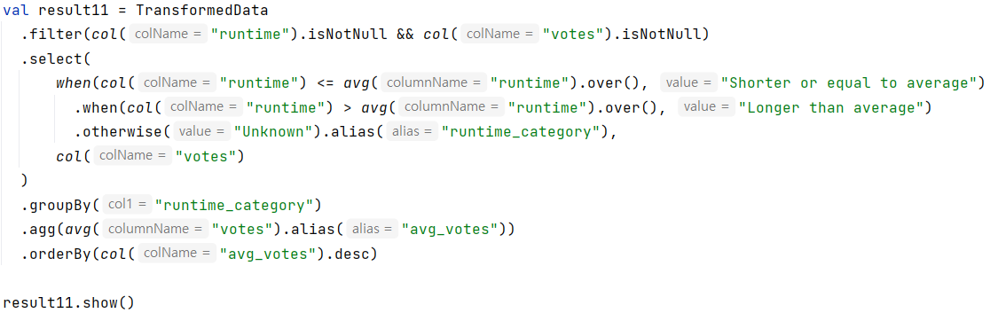
1) People’s choice of Movie run-time

Slide 44
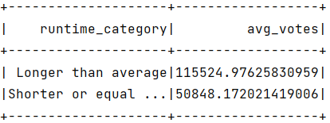
Inferences

Slide 45
MOVIE RECOMMENDATION SYSTEM
Big Data

Slide 46
Recommendation based on movie
In our application , we provide the top 5 recommendations based on the input received from the user.
For recommending top 5 movies, first we find the genre corresponding to the movie given as input by the user.
Later we recommend top 5 movies of that genre based on their IMDB scores.

Slide 47


Slide 48
Recommendation based on star
For recommending top 5 movies based on the actor, we prompt the user to select their favorite actor from the drop - down menu.
Based on the actor, selected we recommend the top 5 movies of the same star with highest IMDB ratings.

Slide 49


Slide 50
Recommendation based on production company
For those of you, who are excited for the movies released by a particular studio or production, we got you covered too!
In our last kind of recommendation, we allow the user to select the production house of their choice and we return the top 5 movies from the selected studio with highest IMDB ratings.

Slide 51


Slide 52
THANK YOU
Big Data

